Slide 1
Chapter 3: System Engineering

Slide 2
Key Takeaway Points
System engineering is a multidisciplinary approach to systems development.
System engineering defines the system requirements and constraints, allocates the requirements to the hardware, software, and human subsystems, and integrates these subsystems to form the system.
Software engineering is a part of system engineering.
3-<number>

Slide 3
What Is a System?
A system is a set of interrelated components.
A system can be big or small, complex or simple, natural or man-made, and exist physically or only conceptually.
Examples:
  the universe
  an ant
  mathematical logic, measurement systems
  a sprinkler system, a telephone system
3-<number>

Slide 4

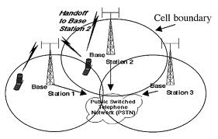
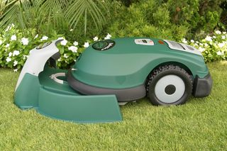

Main Characteristics of a System
A system exists in a hierarchy of systems – a system may be a subsystem of another system.
A system consists of interacting components.
Each system exists in an environment and interacts with the environment.
Systems are ever evolving.
3-<number>

Slide 5
What Is a System Engineering?
System engineering is characterized by:
A system engineering process that covers the entire system life cycle.
A top-down divide-and-conquer approach.
An interdisciplinary approach to system development.
3-<number>

Slide 6




Characteristics of System Engineering
A top-down, divide-and-conquer approach.
Emphasize an engineering process.
Multidisciplinary teamwork is required.
3-<number>

Slide 7
System Engineering Process
System Requirements Definition
System Modeling & Design
Software Development
Hardware Development
Human Resource Development
System Integration & Testing
System Deployment
Legend:
phase/activity
System Maintenance
interaction
work flow
3-<number>

Slide 8
System Requirements Definition
Collecting information about business
goals and current situation.
Deriving business needs from the
discrepancies between the current
situation and business goals.
Identifying Business Needs
System requirements are capabilities that
must be delivered.
Only a subset of needs is satisfied by the
system due to budget and schedule
constraints.
Defining System Requirements
3-<number>

Slide 9
Example of System Requirements
R1. ABHS shall check in and transport luggage to departure gates and baggage claim areas according to the destinations of the passengers.
R2. ABHS shall allow airline agents to inquire about luggage status and to locate luggage.
R3. ABHS shall check all baggage and detect items that are prohibited.
R4. ABHS shall be able to serve 20,000 passengers per day.
3-<number>
Notes:
Airport baggage handling system

Slide 10
Information Collection Techniques
Customer presentation.
Study of current business operation.
User survey.
User interview.
Literature survey.
3-<number>

Slide 11
Focus of Information Collection Activity
1. What is the business that the system will automate?
2. What is the system’s environment or context?
3. What are the business goals or product goals?
4. What is the current business situation, and how does it operate?
5. What are the existing business processes, and how do they relate to each other?
6. What are the problems with the current system?
7. Who are the users of the current system and the future system, respectively?
8. What do the customer and users want from the future system, and what are their business priorities?
9. What are the quality, performance, and security considerations?
3-<number>

Slide 12
Main Characteristics of a System
Decomposing the system into a hierarchy
of functional cohesive, loosely coupled
subsystems, which partition the system
requirements and facilitate reuse of
COTS components.
Decomposing the System
Allocating System Requirements
System requirements are assigned to the
subsystems.
Visualizing System Architecture
The system architecture is depicted using
a certain diagramming technique.
3-<number>

Slide 13
Guidelines for System Decomposition
1. The result should enable separate engineering teams to develop the subsystems.
2. The result should facilitate the use of commercial off-the-shelf (COTS) parts.
3. The result should partition or nearly partition the system requirements.
4. Each subsystem should have a well-defined functionality.
5. The subsystems should be relatively independent.
6. The subsystems should be easy to integrate.
3-<number>

Slide 14
System Decomposition Strategies
1. Decompose the system according to system functions.
2. Decompose the system according to engineering disciplines.
3. Decompose the system according to existing architecture.
4. Decompose the system according to the functional units of the organization.
5. Decompose the system according to models of the application.
3-<number>

Slide 15
Partition According to Major Functionality
System
Subsys-1
Subsys-2
Subsys-3
Subsys-1 (HW)
Subsys-1 (SW)
Subsys-1 (HM)
Subsys-3 (HW)
Subsys-3 (SW)
Subsys-3 (HM)
Subsys-2 (HW)
Subsys-2 (SW)
Subsys-2 (HM)
3-<number>

Slide 16
Partition According to HW, SW & Human Subsystems
System
HW-Subsys
SW-Subsys
HM-Subsys
HW-Subsys1
SW-Subsys1
HM-Subsys1
HW-Subsys2
SW-Subsys2
HM-Subsys2
HW-Subsys3
SW-Subsys3
HM-Subsys3
3-<number>

Slide 17
Requirements Allocation Example
Requirements of an Airport Baggage Handling System:
R1.1. ABHS shall allow airline agents to check in luggage.
R1.2. ABHS shall transport luggage to their destinations within the airport.
R1.2.1. ABHS shall transport luggage from check-in areas to departure gates.
R1.2.2. ABHS shall transport luggage from arrival gates to baggage claim areas.
R1.2.3. ABHS shall transport luggage from arrival gates to departure gates for transfer passengers.
R1.2.4. ABHS shall transport luggage within a terminal using conveyors.
R1.2.5. ABHS shall transport luggage between terminals using DCVs running on high-speed tracks.
R1.3. ABSH shall control the transportation of the luggage within and between the terminals.
3-<number>

Slide 18
Requirements Allocation Example (continued)
R4.1. Each check-in area shall handle 1,150 pieces of check-in luggage per day.
R4.2. Each check-in agent shall check in an average three passengers per minute.
R4.3. Each conveyor hardware shall scan and transport 500 check-in pieces of luggage per hour.
R4.4. ABHS control software shall process 2,300 check-in bags per day and 1,000 bar code scan requests per hour.
3-<number>

Slide 19
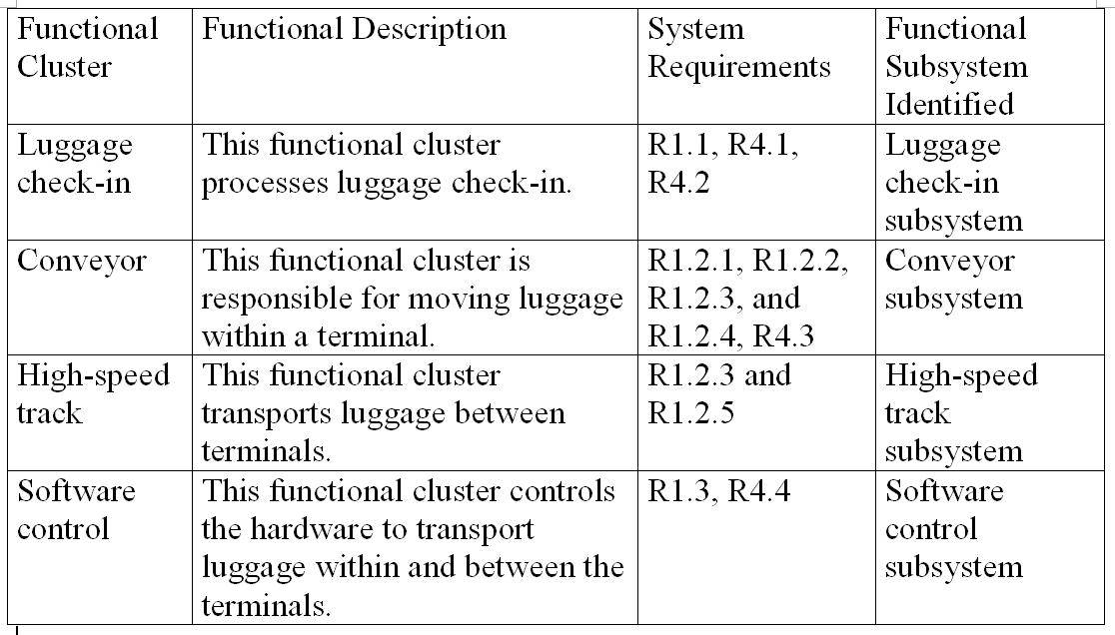
Main Characteristics of a System
3-<number>
Notes:
Trace ability matrix

Slide 20
Main Characteristics of a System
Block diagram
UML component diagram
SysML diagrams
Data flow diagram
and more ...
3-<number>

Slide 21
Block Diagram
Airport Baggage Handling System (ABHS)
Terminal Subsystem
High-Speed Tracks Subsystem
Passenger
luggage
luggage, ticket, ID
luggage
data
ABHS Control Software
instructions
instructions
data
luggage & flight data
Flight Information System
3-<number>

Slide 22
SysML Block Definition Diagram
bdd [package] Structure
Legend:
subsystem or component
Airport Baggage Handling System
consist of
Terminal Subsystem
ABHS Control Software
High-Speed Tracks Subsystem
3-<number>

Slide 23
SysML Internal Block Diagram
ibd [Block] Terminal Subsystem [Nested Flow]
luggage, ID: Material Flow
Passenger Check-In
luggage: Material Flow
Conveyor
Airline Agent (human)
Conveyor Hardware
luggage: Material Flow
High-Speed Track Interface
Passenger Interface
boarding pass, ID: Material Flow
Bar-Code Scanner (HW)
Bag Pushers (HW)
Worker (human)
Check-In Terminal (HW/SW)
bar-code
instructions
ABHS Control Software Interface
ABHS Control Software Interface
Legend:
subsystem or component
input or output port
input & output port
association relation, or port-to-port flow
3-<number>

Slide 24
Other System Engineering Activities
Development of subsystems
  The subsystems are developed by different engineering teams.
  The engineering teams collaborate to jointly solve interdisciplinary problems.
System integration, testing, and deployment
  The subsystems and components are integrated and tested for interoperability.
  The system is tested to ensure that it satisfies the system requirements and constraints.
  The system is then installed and tested in the target environment.
3-<number>

Slide 25
Class Discussion
Why system engineering is a multidisciplinary effort?
What is the relationship between system engineering and software engineering?
Provide examples of systems that require a system engineering approach.
3-<number>

Slide 26
Example
Managers of a department store want to expand into online retailing. This means that the company needs to develop an online system that can take orders online, and ship the ordered items through a designated national shipment carrier. To reduce labor costs, the company wants a fully automated system. Perform the following for this system:
Identify and formulate five functional requirements and two performance requirements for the system.
Decompose the system into a hierarchy of subsystems and allocate the system requirements to the subsystems.
Produce a system architectural design diagram.
3-<number>

Slide 27
functional and performance requirements for the online retailing system (ORS)
R1 ORS shall allow a potential customer to create an online account.
R2 ORS shall allow customers to order online.
R2.1 A customer shall be able to order multiple items in one online transaction.
R2.2 A customer shall be able to make payment using one of several payment methods including credit card, PayPal, personal check, and bank account.
R2.3 A customer shall be allowed to specify a shipping address different from the billing address.
3-<number>

Slide 28
ORS requirements Cont.
R2.4 ORS shall print the shipping label and place it into the designated conveyor cart.
R3 ORS shall dispense the required packaging material such as a carbon box into the designated conveyor cart.
R3.1 ORS shall calculate the volume of the items ordered.
R3.2 ORS shall determine the appropriate packaging material required to ship the ordered items.
3-<number>

Slide 29
ORS requirements Cont.
R4 ORS shall direct the conveyor cart to traverse the conveyor network to load the ordered items.
R5 ORS shall dispense the ordered items when the conveyor cart traverses by the ordered items.
R6 ORS shall direct the conveyor cart to the packaging area when all of the ordered items are loaded.
R7 ORS shall ensure efficient utilization of the conveyor subsystem with different sizes of conveyor carts to accommodate different volumes of orders. (A nonfunctional requirement.)
3-<number>

Slide 30
ORS requirements Cont.
R8 ORS shall ensure that the dispensers have enough time to correctly dispense the ordered items into the designated conveyor carts. (A nonfunctional requirement.)
R9 The conveyor belt shall traverse at a speed of X feet per second. (A performance requirement.)
R10 ORS shall be able to process Y transactions per minute. (A performance requirement.)
…and more
3-<number>

Slide 31
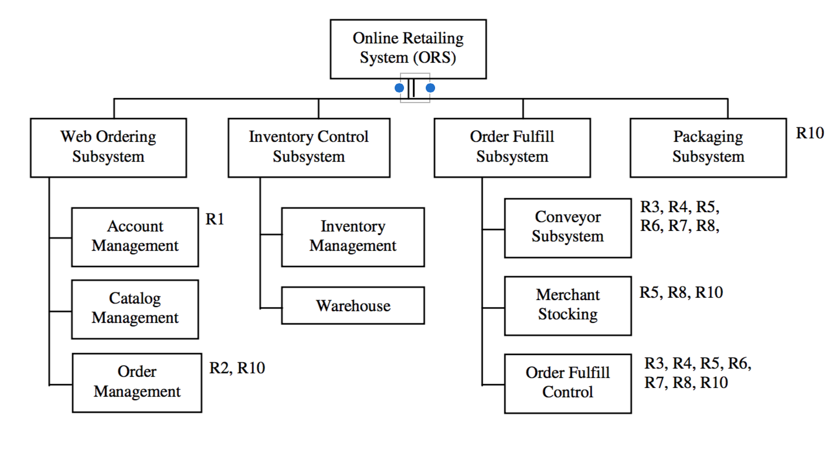
Online ordering system decomposition and allocation
3-<number>

Slide 32
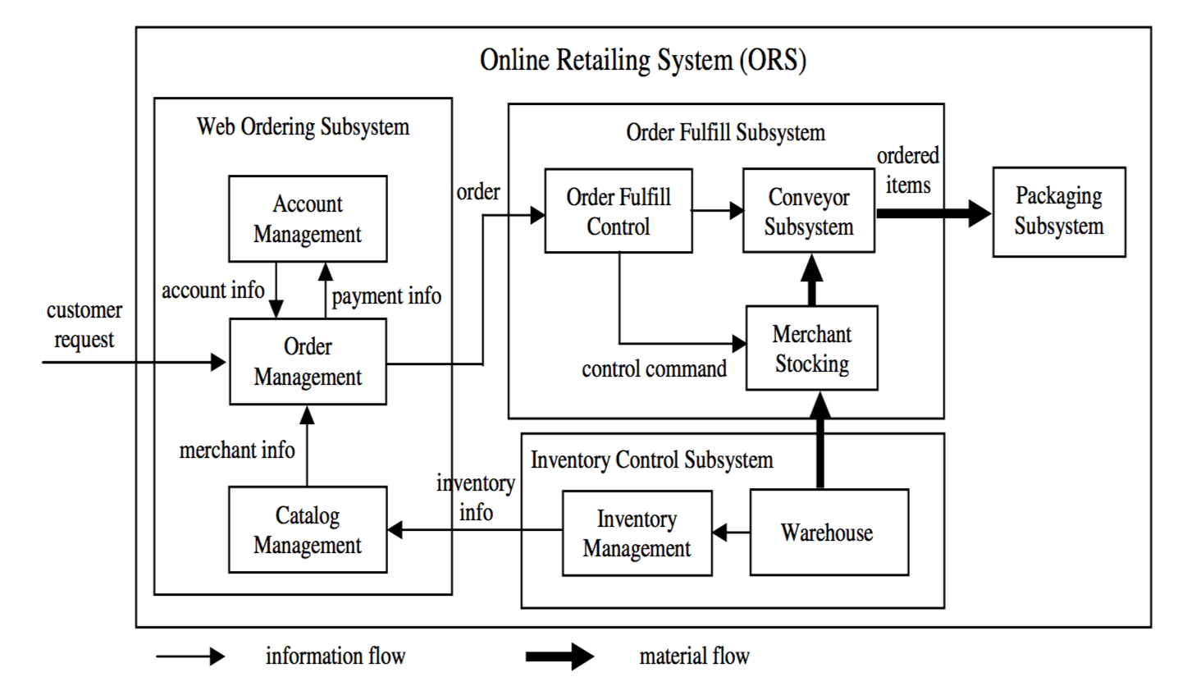
ORS Architectural Design
3-<number>

